Slide 1
FPGA DESIGN FLOW
Using a 2×2 Matrix Multiplier
Notes:
Since matrix multiplication is used almost everywhere in modern computing, we'll use it as our example throughout today's session."

Slide 2




What do ,ChatGPT, Instagram filters, Image processing and Netflix, YouTube recommendations have in common?

Slide 3
MATRIX MULTIPLICATION

Slide 4
FLOW : -
DESIGN
Simulate
Synthesize
Implement
Program the FPGA

Slide 5
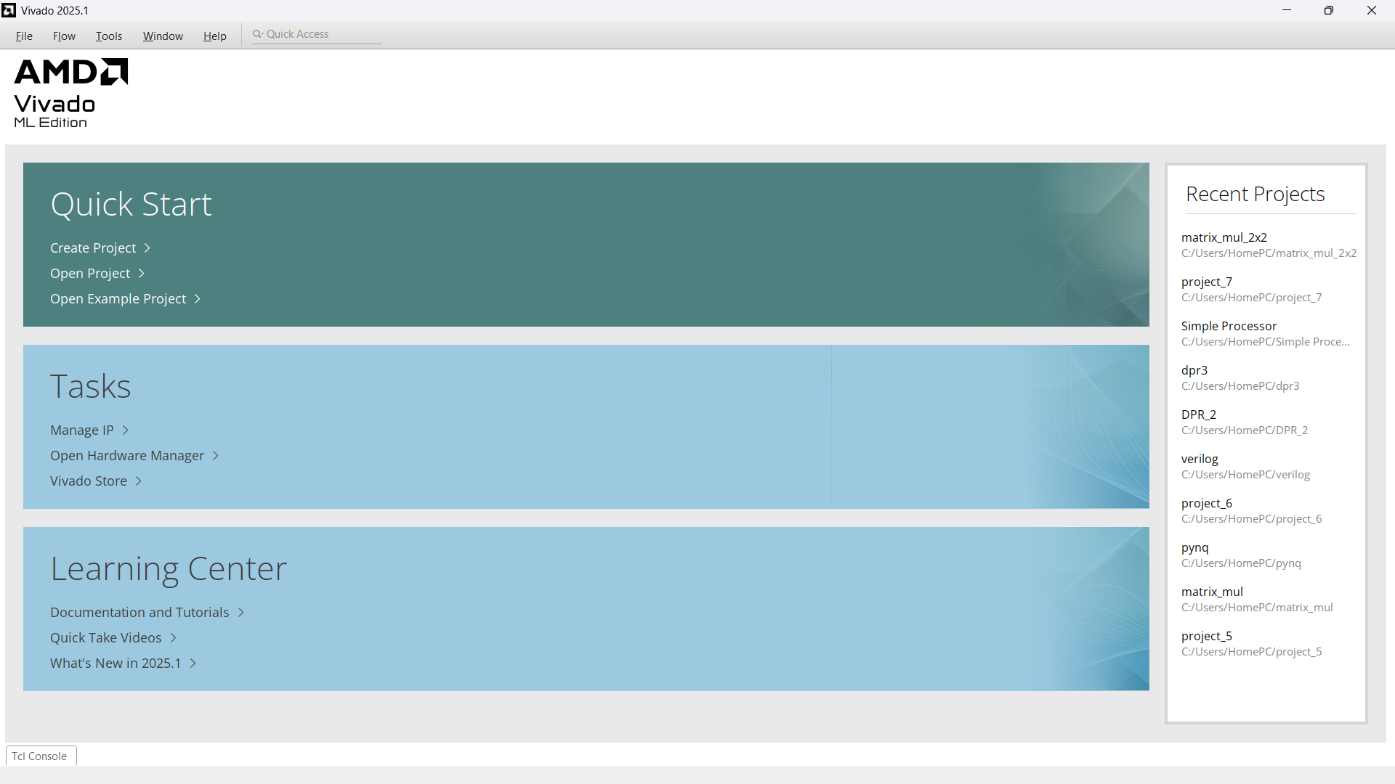

Slide 6
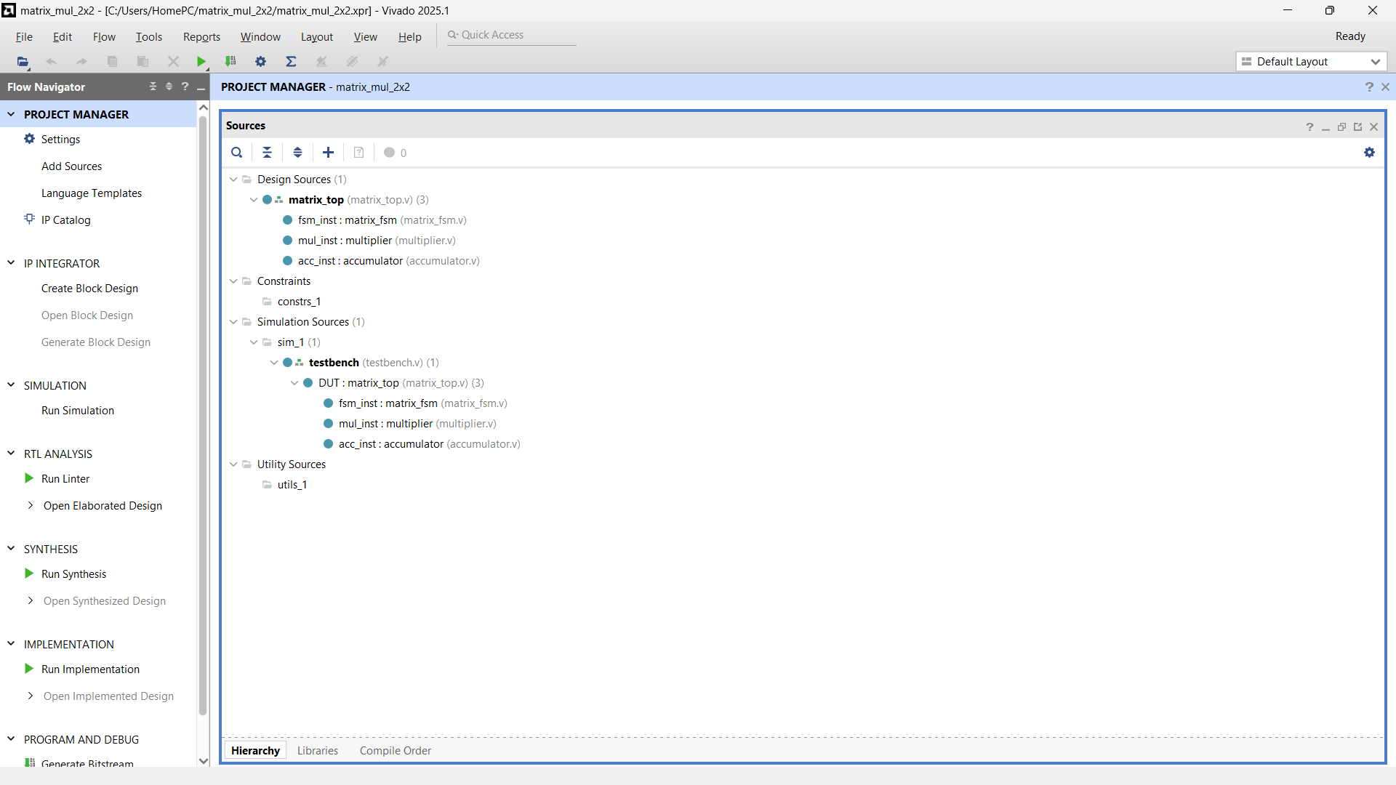
Create a project and add all the Files

Slide 7
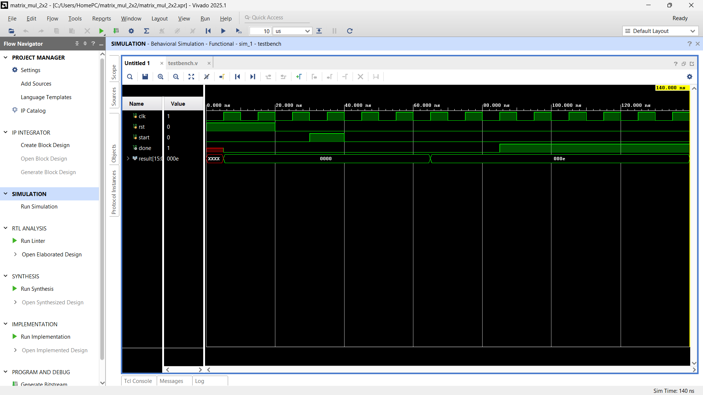
This is what you will get after u press run simulation

Slide 8
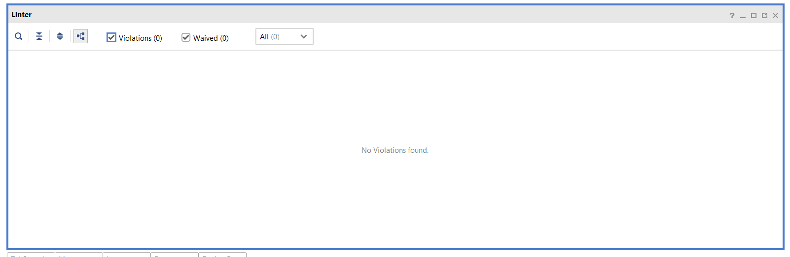
Linting is the process of checking your Verilog code for coding mistakes, bad design practices, and potential bugs before creating the hardware.
It does not create hardware and does not modify your code. It only reports warnings and errors.
Notes:
What does it check?
Syntax errors
Unused signals
Width mismatches
Missing default cases
Latch inference
Multiple drivers
Bad coding practices
One-line explanation
Linting is like a grammar checker for Verilog—it checks whether your code follows good design practices before moving to the next stage.

Slide 9
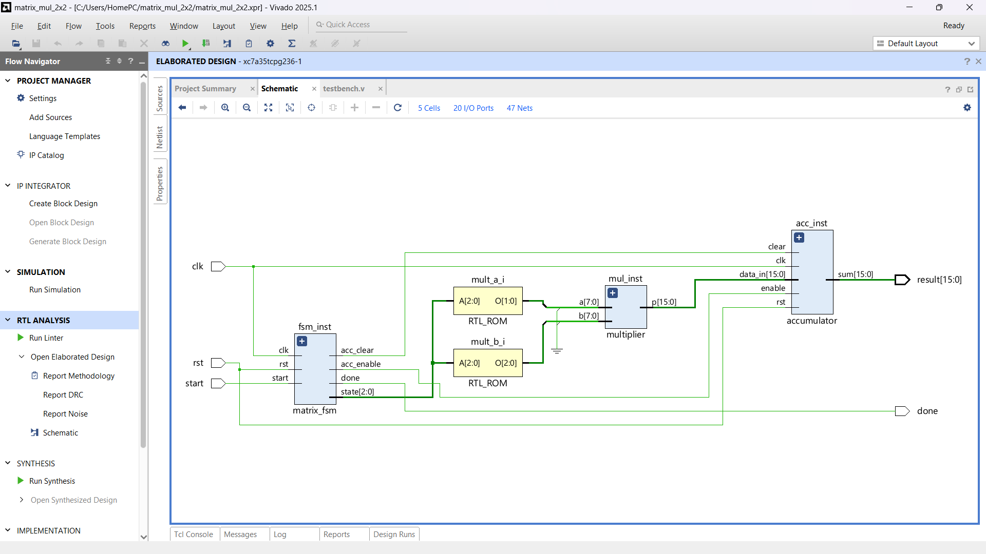
This is the elaborated design
ROM A
\
→ Multiplier → Accumulator → Result
/
ROM B
Notes:
The Elaborated Design shows the logical architecture of our design (RTL). It tells us what modules exist and how they are connected, but it does not show how they will be implemented inside the FPGA. That happens during Synthesis.
Why do we open the Elaborated Design?
It helps us verify that:
All modules are connected correctly.
The hierarchy of the design is correct.
Inputs and outputs are connected as expected.
Data flows through the design correctly.
No module is missing or disconnected.

Slide 10
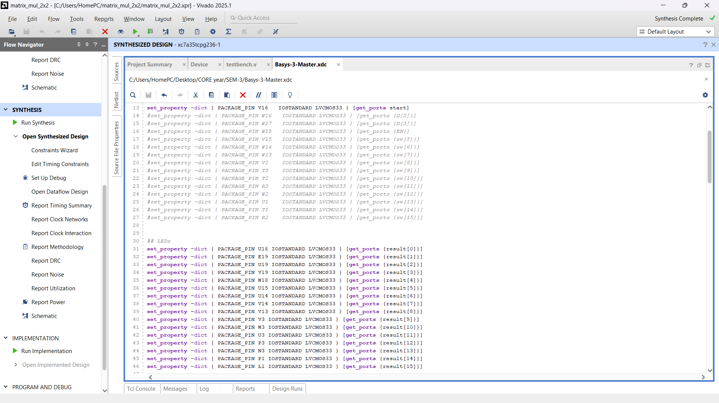
Before synthesis update your constraint file according to your code

Slide 11
What is synthesis?
Synthesis is the process of converting the Verilog RTL code into actual FPGA hardware components such as LUTs, Flip-Flops, DSPs, BRAMs, Multiplexers, and Carry Chains.
What happens during synthesis?
Vivado performs several tasks:
Reads all Verilog modules.
Optimizes the logic.
Removes unused hardware.
Simplifies Boolean expressions.
Infers FPGA resources (LUTs, FFs, DSPs, BRAMs).
Generates a technology-specific netlist.

Slide 12
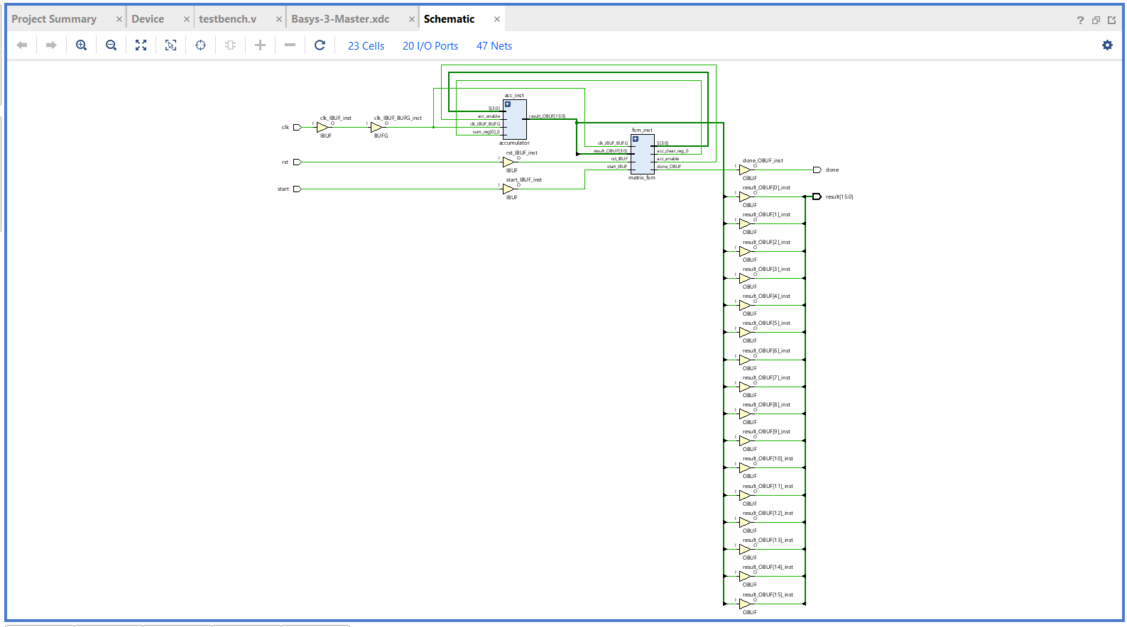

Slide 13
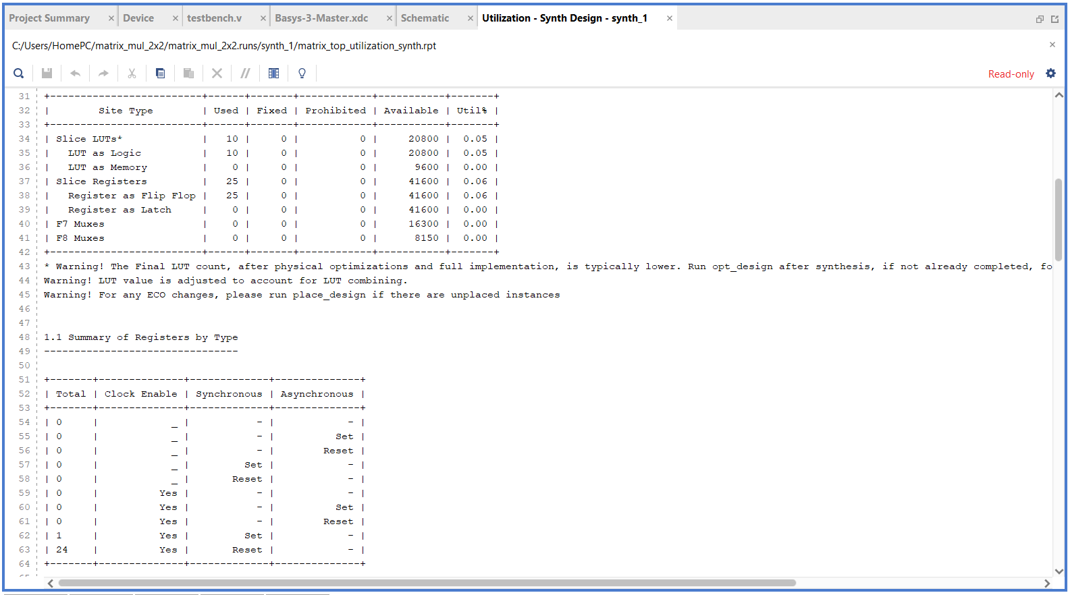

Slide 14
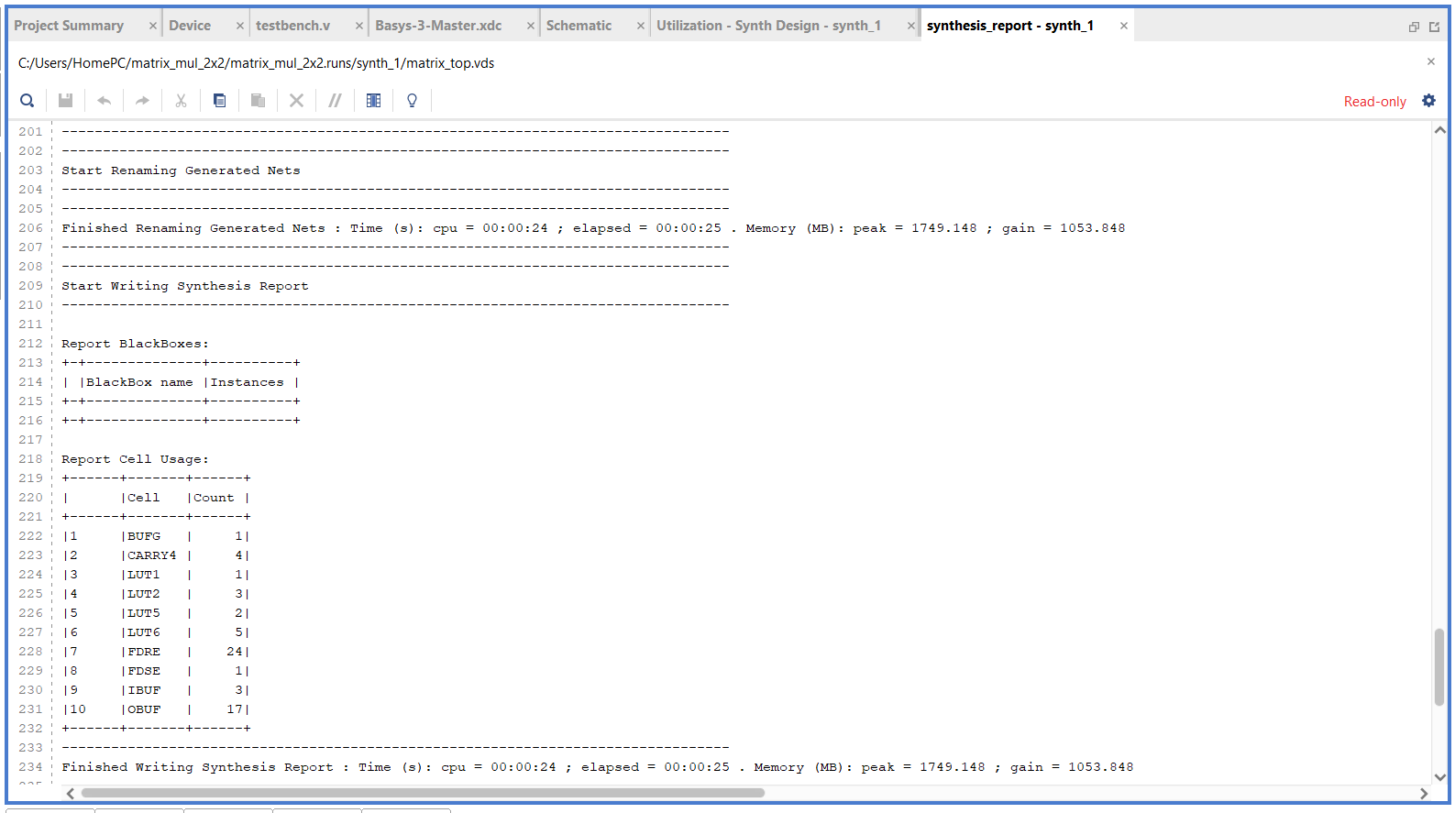

Slide 15
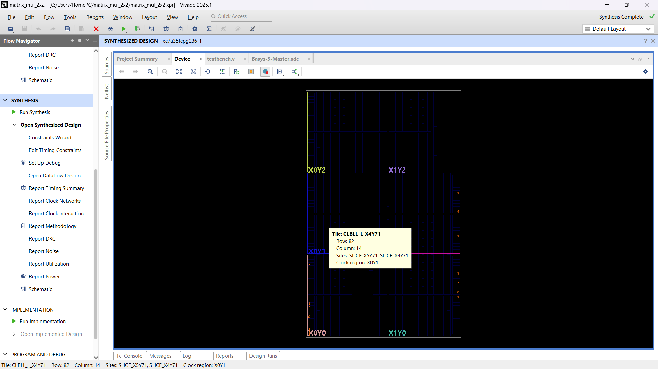
Device view of FPGA chip

Slide 16
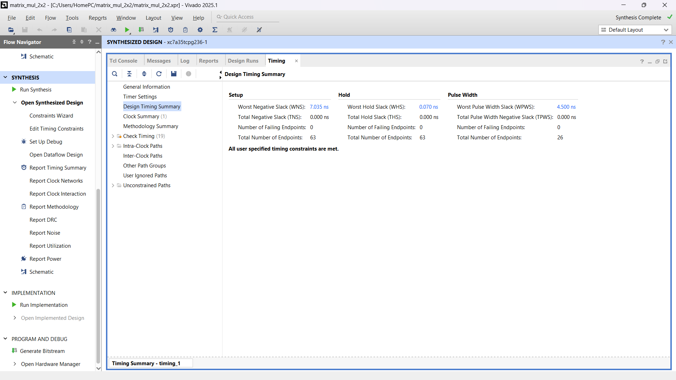

Slide 17
NOW LET’S RUN IMPLEMENTATION

Slide 18
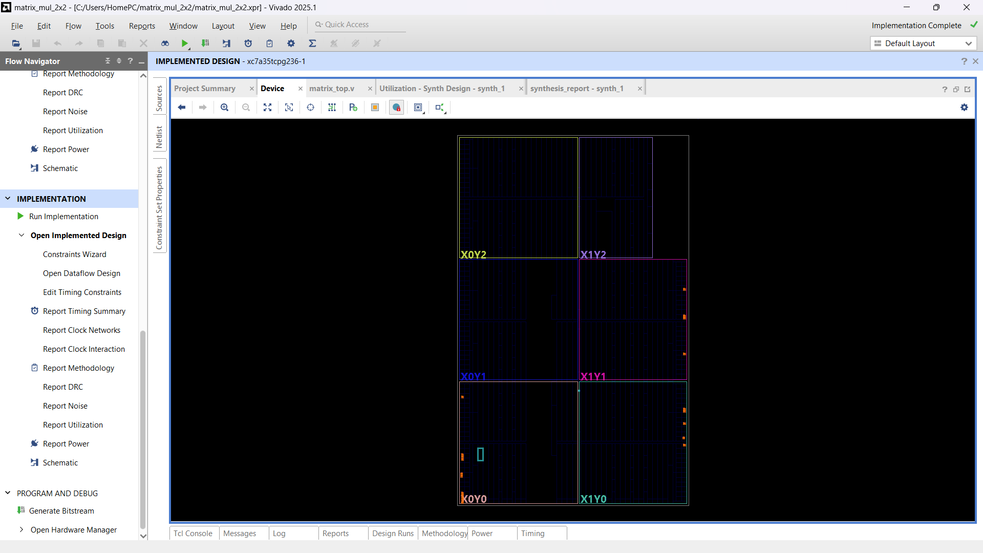
Device view of FPGA after Implementation

Slide 19
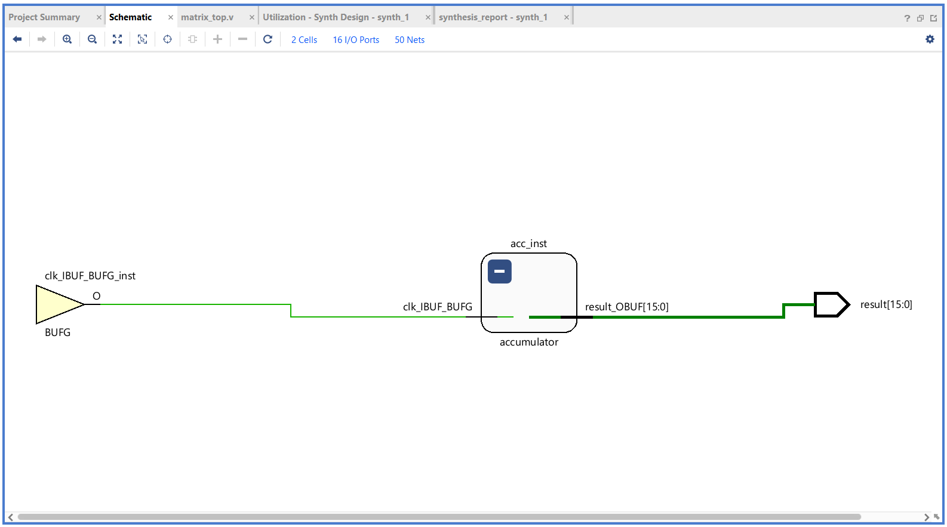
Data flow design after Implementation

Slide 20
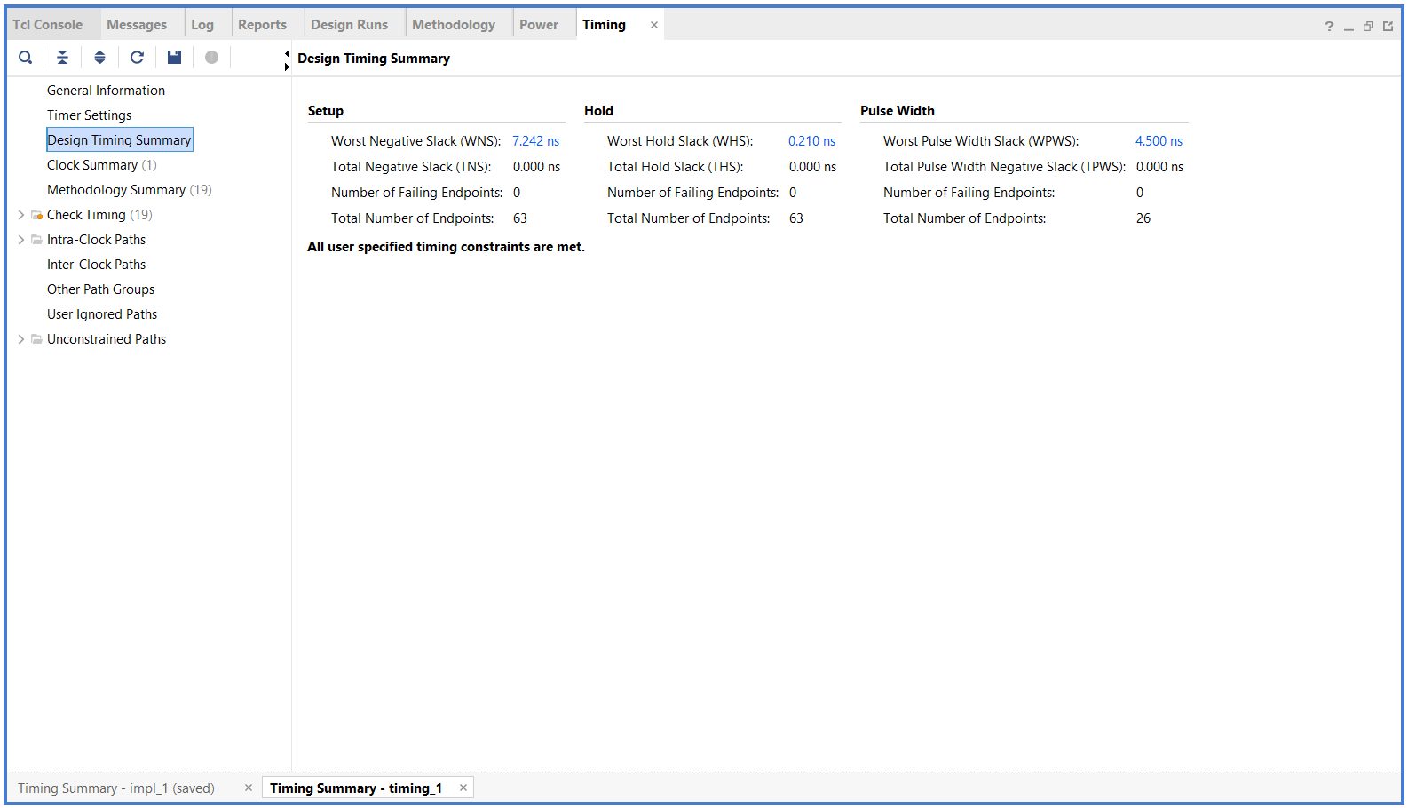
Timing summary after implementation

Slide 21
Difference between Synthesis and Implementation
Synthesis | Implementation
Converts Verilog into FPGA resources | Places those resources on the FPGA
Creates netlist | Creates physical layout
Maps logic to LUTs, FFs, DSPs | Maps LUTs, FFs, DSPs to exact locations
Estimates timing | Calculates final timing
No routing | Routing completed

Slide 22
Difference between Synthesized and Implemented Schematic
Synthesized Schematic | Implemented Schematic
Shows logical hardware | Shows placed and routed hardware
FPGA primitives inferred | FPGA primitives physically located
No routing | Routing completed
Estimated timing | Actual timing
Before placement | After placement

